Slide 1
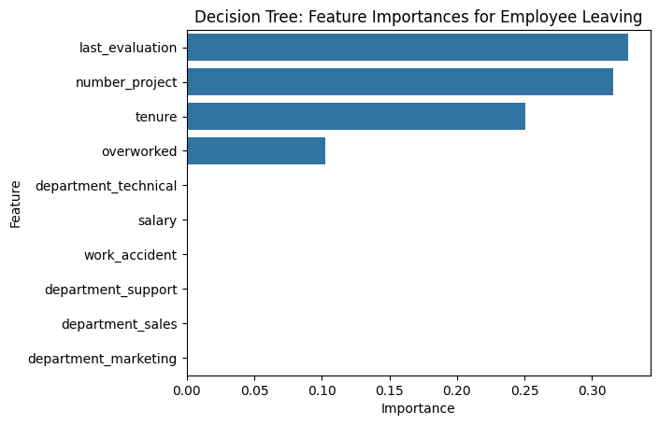
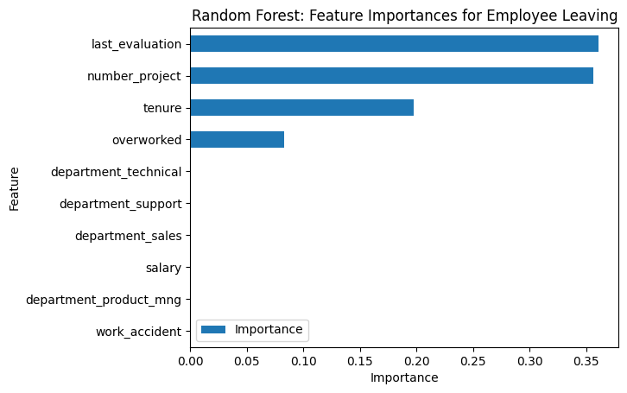
Salifort Motors Employee Retention Analysis
BUSINESS PROBLEM
Salifort Motors seeks to understand the key drivers of employee retention. This analysis aimed to identify factors contributing to turnover, a costly issue that impacts productivity and morale, and to answer the following question:
What’s likely to make the employee leave the company?
RESPONSE
To predict this categorical outcome, we evaluated several machine learning models. A Random Forest model was selected, as it demonstrated the highest accuracy and predictive power, slightly outperforming a standard decision tree and logistic regression model.
This chart displays the most relevant. The top four factors are last_evaluation, number_project, tenure, and overworked.
IMPACT
This model provides a powerful tool for the HR department. It predicts whether an employee will leave but also identifies the key factors driving that decision. These insights enable HR to shift from a reactive to a proactive approach, implementing targeted interventions to improve employee retention before valuable talent is lost.
This chart confirms the findings from the decision tree. The same variables, last_evaluation, number_project, tenure, and overworked, are identified as the most significant predictors.
INSIGHTS/NEXT STEPS
Manage Workload and Prevent Burnout:
Cap the number of projects assigned to an employee. Data suggests 3-4 projects is sustainable.
Re-evaluate overtime expectations. Incentivize or reduce overtime and ensure workload and time-off policies are explicit.
Improve Career Progression and Recognition:
Investigate dissatisfaction among 4-year tenured employees. This group may lack growth opportunities and implement clear promotion paths.
Reform the performance evaluation system. Reward employees for contribution and impact, not just hours worked.
Enhance Workplace Culture:
Facilitate discussions to openly address the work culture and identify pain points within different departments.

